Slide 1
Coordinate Geometry

Slide 2
Coordinate Geometry
Coordinate geometry is a branch of mathematics that deals with geometrical figures in a two-dimensional plane. This helps in learning about the properties of these figures.
Coordinates of a shape help in easy location of the shape on the map. When we have to locate anything on the earth, we use the coordinates of the earth in the form of latitude and longitude.

Slide 3
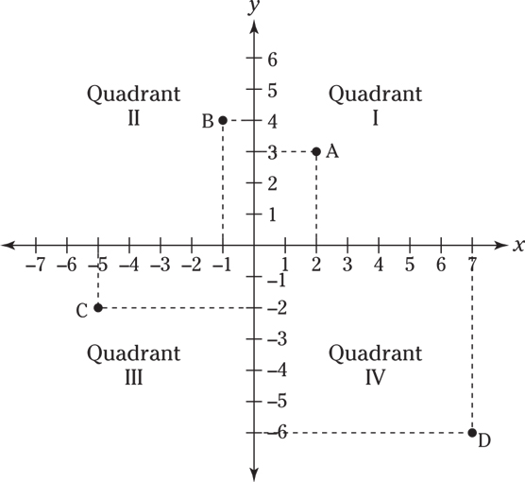
Coordinate Plane
A Cartesian plane divides the plane in two dimensions that allows locating of the points easily. The Cartesian plane or coordinate plane works in two axes: a horizontal axis and a vertical axis, known as x-axis and y-axis. These axes of the coordinate plane divide the plane into four quadrants which intersect at a common point called origin with coordinates as (0,0).

Slide 4
Coordinates of a Point
To locate any point in space, coordinates of the point acts as an address of the point. (x,y) are the coordinates of a point. Some of important terms linked with coordinates are:
Abscissa: The value of the x-coordinate of a point on the coordinate plane is called its abscissa. It is also known as the distance of the point from the x-axis.
Ordinate: The y-coordinate of a point on the coordinate plane is called its ordinate. It is also known as the distance of the point from the y-axis.

Slide 5
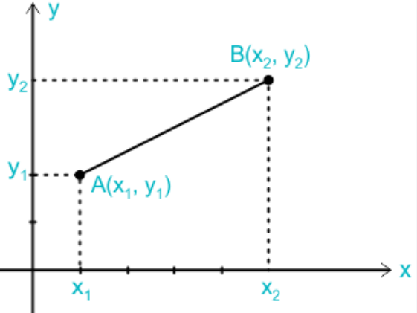
Coordinate Geometry Distance Formula
In order to find the distance between the two points (x1,y1)
and (x2,y2)
on the Cartesian plane is written as the square root of the sum of the square of the difference between x-coordinates and the y-coordinates of the given point.

Slide 6
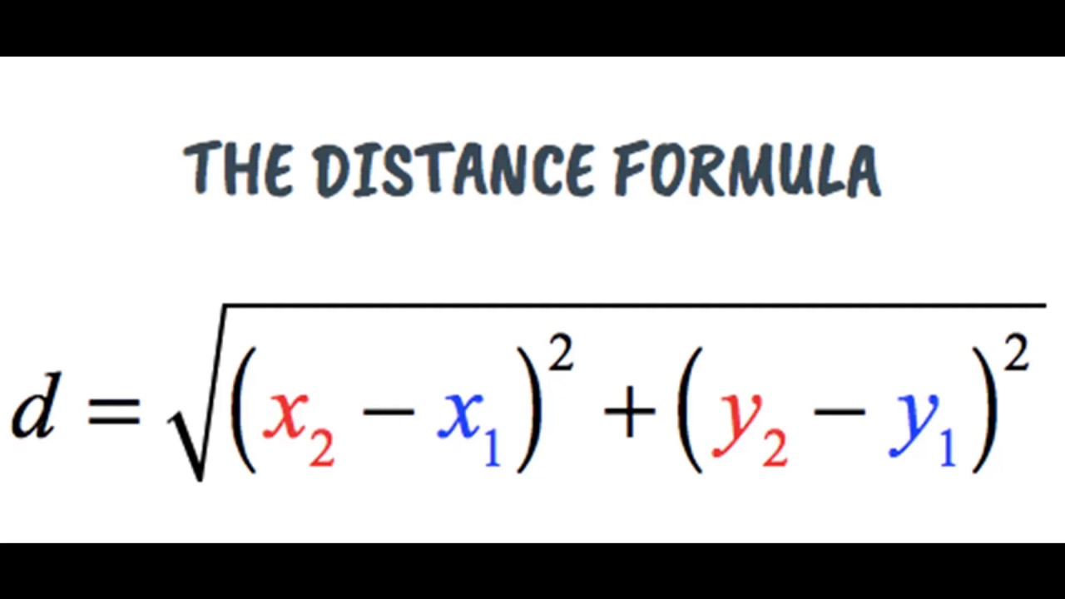

Slide 7
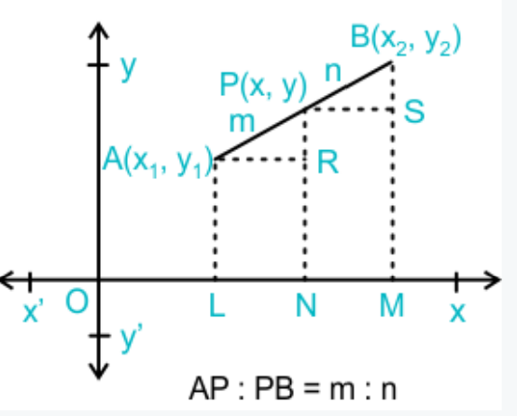
Section Formula in Coordinate Geometry
Section formula in coordinate is used for finding the coordinates of the point on a line with endpoints (x1,y1) and (x2,y2) in the Cartesian plane that divides the line in the ratio m:n. This point can lie either between these two points or outside the line segment joining these points.

Slide 8
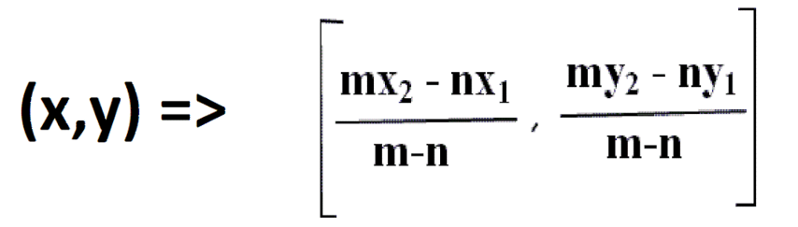
Section Formula

Slide 9
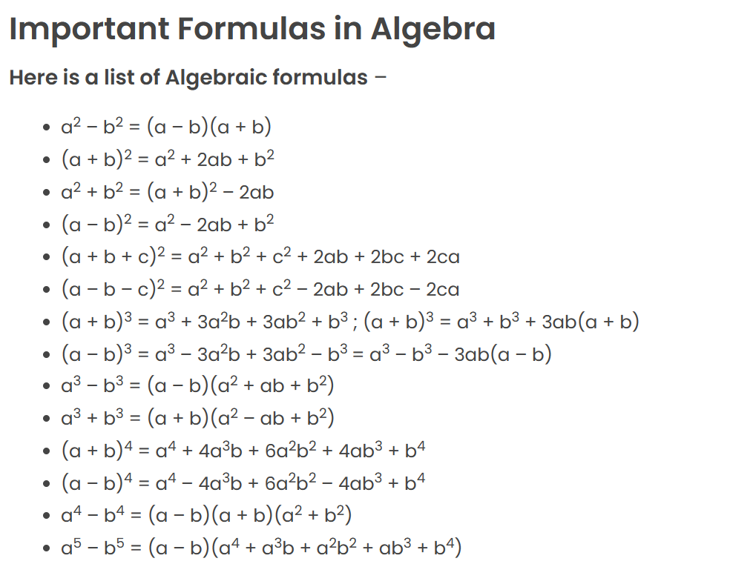

Slide 10
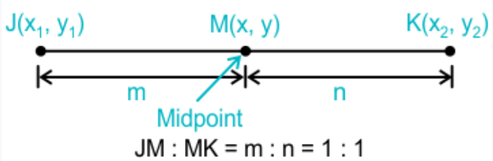
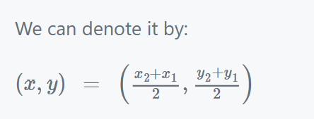
Midpoint Formula in Coordinate Geometry
Midpoint formula in coordinate geometry is a special case in the section formula where the point divides the line in the ratio 1:1. For a line joining the points (x1,y1) and (x2,y2), midpoint of a given line is obtained by finding the average of x-values of the two given points and the average of y-values of the two given points.

Slide 11
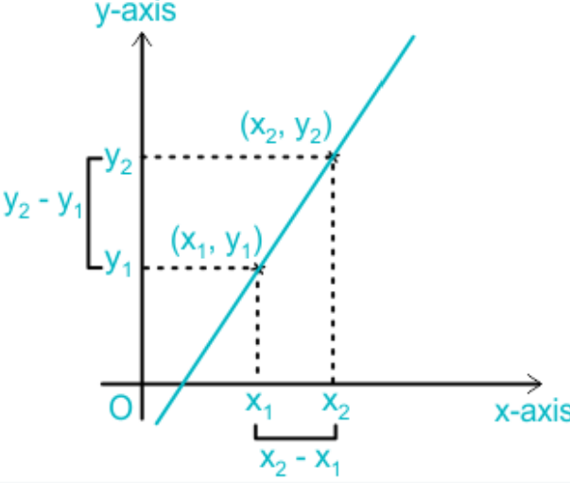
Slope Formula
The inclination of the line with respect to the axis is called the slope of the line. We generally calculate the slope by finding the angle made by the line with the x-axis, or it can also be found by considering any two points on the line.

Slide 12
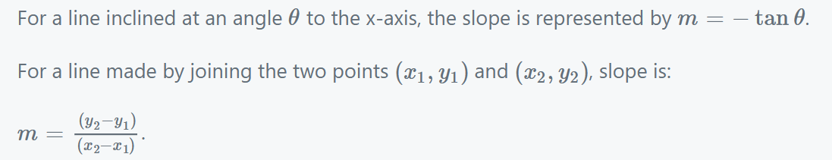
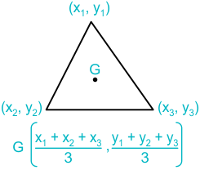
Centroid of a Triangle
We know that the centroid of a triangle is the point of intersection of all the three medians of a triangle. And median of a triangle is the line joining the vertex of the triangle to the midpoint of the opposite side.

Slide 13
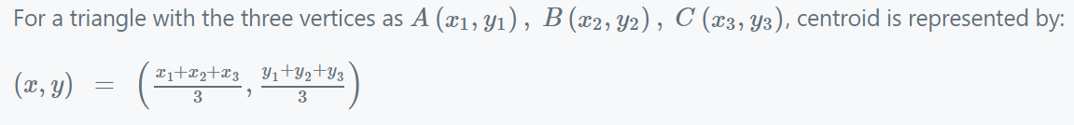
Equation of Shapes in Coordinate Geometry
Using the points on a given regular shape, its equation can be determined in coordinate geometry. We can find the equations of line, circle, parabola, hyperbola, etc using some specific formulae

Slide 14
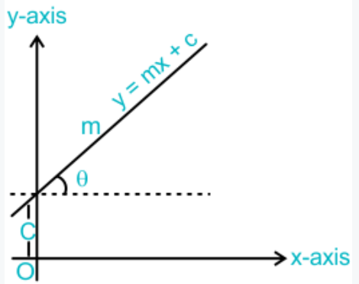
Equation of Line in Coordinate Geometry
Equation of a line represents the positions of all the points on the line. The standard equation of a line is given as ax + by + c = 0.
However, there is yet another method to find the equation of a line. This is called the slope-intercept method. The equation of a line in the slope intercept form is given as:
y = mx + c
Here, m is the slope of the line, and c is the y-intercept of the line.

Slide 15
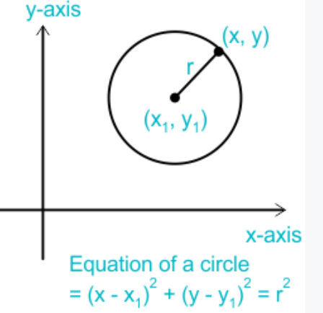
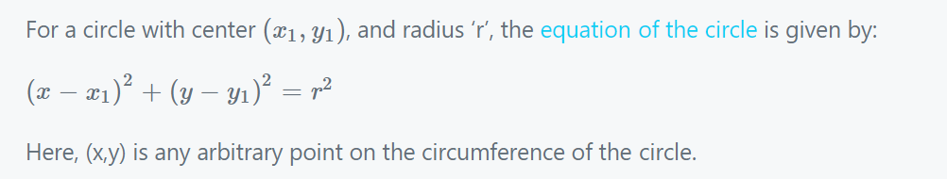
Equation of a Circle in Coordinate Geometry
With the help of a simple equation of a circle we get precise information about the center of the circle and the radius of the circle.

Slide 17
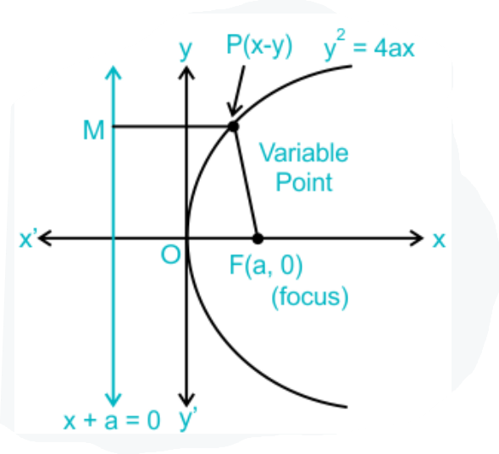
Equation of a Parabola, Hyperbola, and Ellipse
We know that Parabola in geometry is a symmetric U-shaped curve, with every point on the figure being at an equal distance from a fixed point known as focus of the parabola.

Slide 18
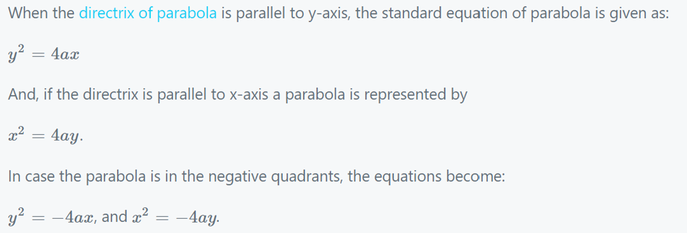

Slide 19
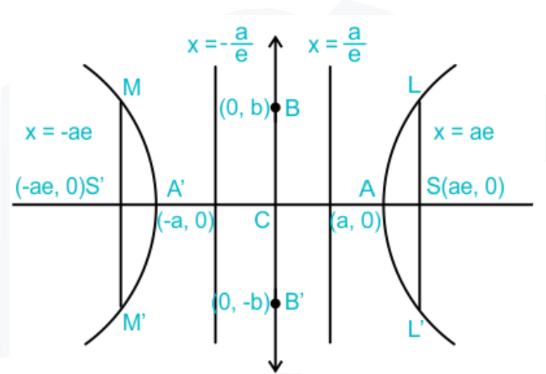
Hyperbola is an open curve with two branches that are a mirror image of each other. Also, we can define hyperbola as a locus of point moving in a plane in a way that the ratio of its distance from a fixed point that is focused to that of a fixed line that is directrix is a constant that is greater than 1.
We can write the equation of an hyperbola in the simplest form when the center of the hyperbola is at the origin, and the focus lies on either of the axis.
The standard equation of a hyperbola is:
X^2/a^2−y^2/b^2=1
, with b^2=a^2(e^2−1)

Slide 20
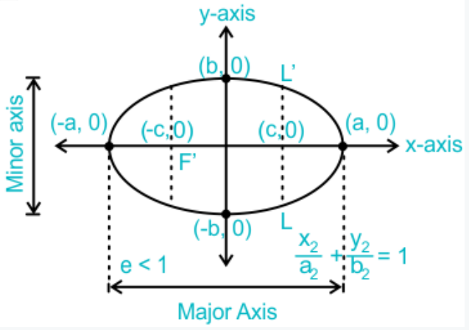
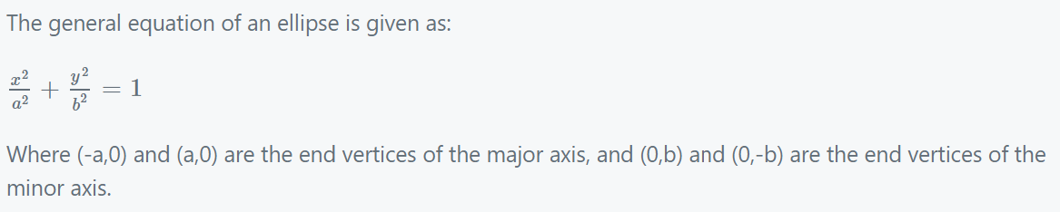
Ellipse on the other hand is a geometrical figure that is defined as a locus of point that has a ratio between the distance from a fixed point and the fixed line as ‘e’, where e is the eccentricity of the ellipse.

Slide 21
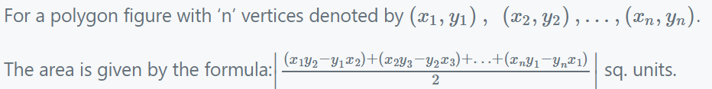
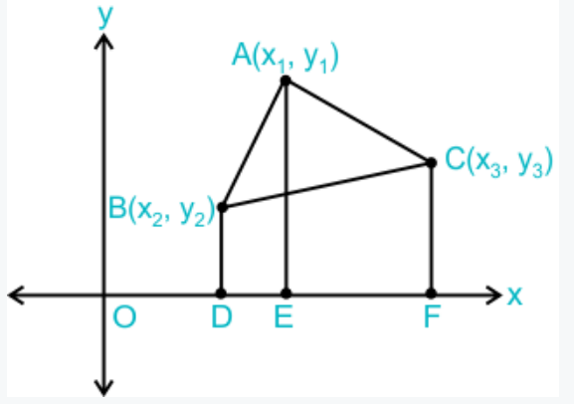
Area of Polygons in Coordinate Geometry
Area of a Triangle in Coordinate Geometry
Triangle is a special type of polygon with three sides. For a triangle ABC with vertex A(x1,y1), B(x2,y2), and C(x3,y3), the area of a triangle is represented by:
Area of triangle ABC= ½{x1(y2−y3)+x2(y3−y1)+x3(y1−y2)}sq. units.

Slide 22
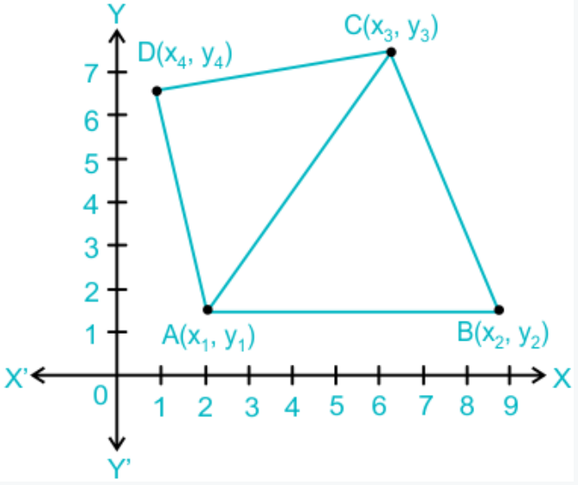
Area of a Quadrilateral in Coordinate Geometry
Quadrilateral is a geometrical figure with four sides and 4 vertices. For a quadrilateral ABCD with vertices A(x1,y1), B(x2,y2), C(x3,y3), and D(x4,y4)
the area is represented by:
Area of a quadrilateral ABCD= 1/2{(x1−x3)(y2−y4)−(x2−x4)(y1−y3)}sq. units.

Slide 23
Applications of Coordinate Geometry
Some of the common applications of coordinate geometry are:
Used for figuring out the distance between two objects.
Coordinate geometry is used in computer monitors. Some complex curves, shapes and conics are better interpreted with algebraic equations that would otherwise be difficult to analyze using pure geometry.
Geometry finds its use in the human digestive system as it involves organizing of tubes within a tube.
Using coordinate geometry we can easily locate and get the precise location of a place in the actual world.
Air traffic is regulated using coordinate geometry. A slight movement in the aircraft up, down, left or right leads to the change in the position of the aircraft in the coordinate axis.

Slide 24
Example: Find the distance of the point P (2, 3) from the x-axis.
Solution:
We know that,
(x, y) = (2, 3) is a point on the Cartesian plane in the first quadrant.
x = Perpendicular distance from y-axis
y = Perpendicular distance from x-axis
Therefore, the perpendicular distance from x-axis = y coordinate = 3
Example: Find a relation between x and y such that the point (x, y) is equidistant from the points (7, 1) and (3, 5).
Solution:
Let P(x, y) be equidistant from the points A(7, 1) and B(3, 5).
Then, AP = BP
AP^2 = BP^2
Using distance formula,
(x – 7)^2 + (y – 1)^2 = (x – 3)^2 + (y – 5)^2
X^2 – 14x + 49 + y^2 – 2y + 1 = x^2 – 6x + 9 + y^2 – 10y + 25
x – y = 2
Hence, the relation between x and y is x – y = 2.

Slide 25

Example: Find the ratio in which the line segment joining the points (– 3, 10) and (6, – 8) is divided by (– 1, 6).
Solution:
Let the ratio in which the line segment joining ( -3, 10) and (6, -8) is divided by point ( -1, 6) be k:1.
Therefore by section formula,
-1 = ( 6k-3)/(k+1)
–k – 1 = 6k -3
7k = 2
k = 2/7
Hence, the required ratio is 2 : 7.

Slide 26
Example: Find the area of triangle PQR formed by the points P(-5, 7), Q(-4, -5) and R(4, 5).
Solution:
Given,
P(-5, 7), Q(-4, -5) and R(4, 5)
Let P(-5, 7) = (x1, y1)
Q(-4, -5) = (x2, y2)
R(4, 5) = (x3, y3)
Area of the triangle PQR = (½){x1(y^2 – y3) + x^2(y3 – y1) + x3(y1 – y2)}
= (½) {-5(-5 – 5) + (-4)(5 – 7) + 4(7 + 5)}
= (½) {-5(-10) -4(-2) + 4(12)}
= (½) {50 + 8 + 48}
= (½) × 106
= 53

Slide 27
Example: Write the coordinates of a point on the x-axis which is equidistant from points A(-2, 0) and B(6, 0).
Solution:
Let P(x, 0) be a point on the x-axis.
Given that point, P is equidistant from points A(-2, 0) and B(6, 0).
AP = BP
Squaring on both sides,
(AP)² = (BP)²
Using distance formula,
(x + 2)² + (0 – 0)² = (x – 6)² + (0 – 0)²
x² + 4x + 4 = x² – 12x + 36
4x + 12x = 36 – 4
16x = 32
x = 2
Therefore, the coordinates of a point on the x-axis = (2, 0).

Slide 28
Practice Questions:
Find a point on the y-axis equidistant from (-5, 2) and (9, -2)
A] 1
B] 3
C] -7
D] 0
Find the distance between the points (-8/5, 2) and (2/5, 2).
A] 1
B] 2
C] 5/7
D] 0

Slide 29
The center of a circle is (2a, a – 7). Find the values of a, if the circle passes through the point (11, –9) and has a diameter 10√ 2 units.
3,5
1,5
1,8
2,3
Points P (5, -3) is one of the two points of trisection of the line segment joining points A(7, -2) and B(1, -5) near to A. find the coordinates of the other point of trisection.
1,2
1,7
3,-4
2,3

Slide 30
Find the area of quadrilateral ABCD whose vertices are A (1, 0), B (5, 3), C (2, 7), D ( -2, 4).
12
17
18
25
6. Points P,Q,R and S divide the line segment joining the points A(1,2) and B(6,7) in 5 equal parts. Find the coordinates of the points P,Q and R.
4,5
1,8
2,3
1,2

Slide 31
Find the relation between x and y if points (2, 1), (x, y) and (7, 5) are collinear.
4x−5y−3=0
2x−5y−3=0
3x−5y−3=0
4x−7y−3=0
If A (-2, 4), B (0, 0) and C (4, 2) are the vertices of triangle ABC, then find the length of the median through the vertex A.
12
5
18
23

Slide 32
If points A (4, 3) and B (x, 5) are on the circle with center O (2, 3), find the value of x.
12
17
18
23
If vertices of a triangles are (1, k), (4, -3) and (-9, 7) and its area is 15 sq. units then find then the value of k.
2
1
8
3

Slide 33
Find the area of triangle ABC whose vertices are A (-5, 7), B (-4, -5) and C (4, 5).
12
17
18
53
If point A (0,2) is equidistant from the point B (3, p)and C (p, 5), find p.
1
7
8
3

Slide 34
13.Find a relation between x and y if the points A(x, y), B(-4, 6) and C(-2, 3) are collinear.
2x+y+3=0
3x+y+3=0
9x+y+3=0
2x+y+7=0
14.Find the area of a triangle whose vertices are given as (1, -1), (-4, 6) and (-3, -5).
12
17
18
24

Slide 35
15. What is the equation for the line running through (2,4) and parallel to 6x+3y=12?
y=−2x+8
y=−2x+7
y=−2x+5
y=−2x+4
16. Which of the following is parallel to the line running through the points (4,5) and (8,4)?
4y+x=13
4y+x=7
4y+x=10
4y+x=11

Slide 36
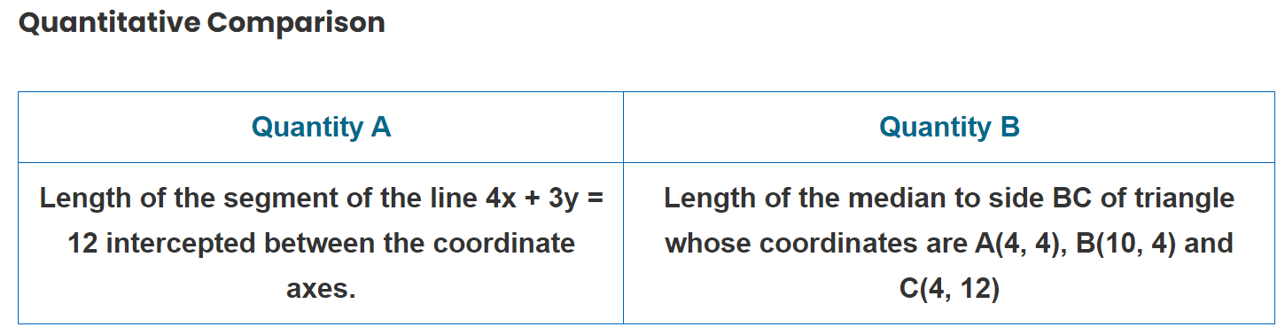
17.
Quantity A is greater
Quantity B is greater
The two quantities are equal
Cannot be determined

Slide 37
18. Vertices of a quadrilateral ABCD are A(0, 0), B(4, 5), C(9, 9) and D(5, 4). What is the shape of the quadrilateral?
Square
Rectangle but not a square
Rhombus
Parallelogram but not a rhombus
19. Find the coordinates of the point which divides the line joining (5, -2) and (9, 6) internally in the ratio 1 : 3.
(6, 0)
(6, 3)
(0, 6)
(3, 6)

Slide 38
20. A and B are two points with the co-ordinates (-2, 0) and (0, 5). What is the length of the diagonal AC if AB form one of the sides of the square ABCD?
29−−√
58−−√
116−−−√
229−−√

Slide 39


